Slide 1
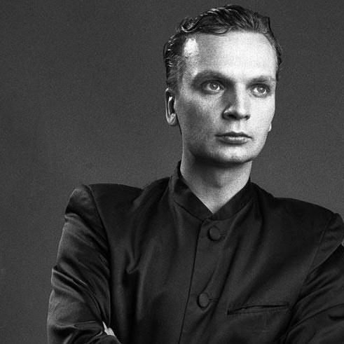
Grzegorz Ciechowski
Musician, composer, songwriter, music producer, film music composer, poet.

Slide 2
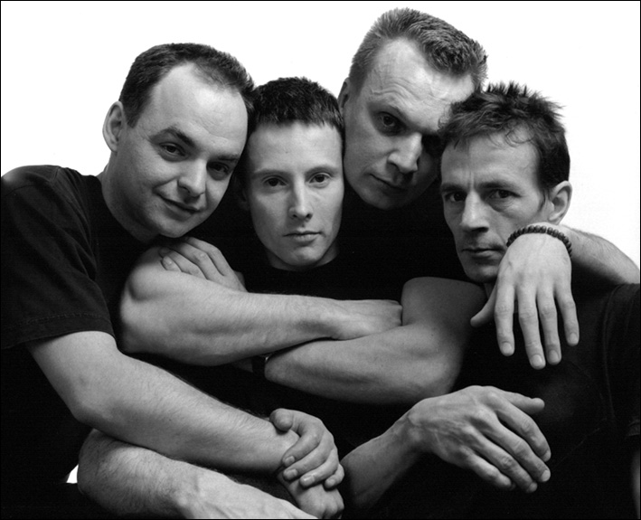
Curriculum vitae
Ciechowski became known in the 80’s as a founder and frontman of the band Republika, which was one of Poland's most popular rock groups. In the mid-1980s, Ciechowski began a solo career under the pseudonym Citizen GC - again with commercial success.

Slide 3
Ciechowski also composed for other Polish artists and produced an album for German vocalist Mona Mur. He wrote music for the German television show Schloß Pompon Rouge. He is also the author of the soundtrack for the movie "The Witcher".
Curriculum vitae

Slide 4
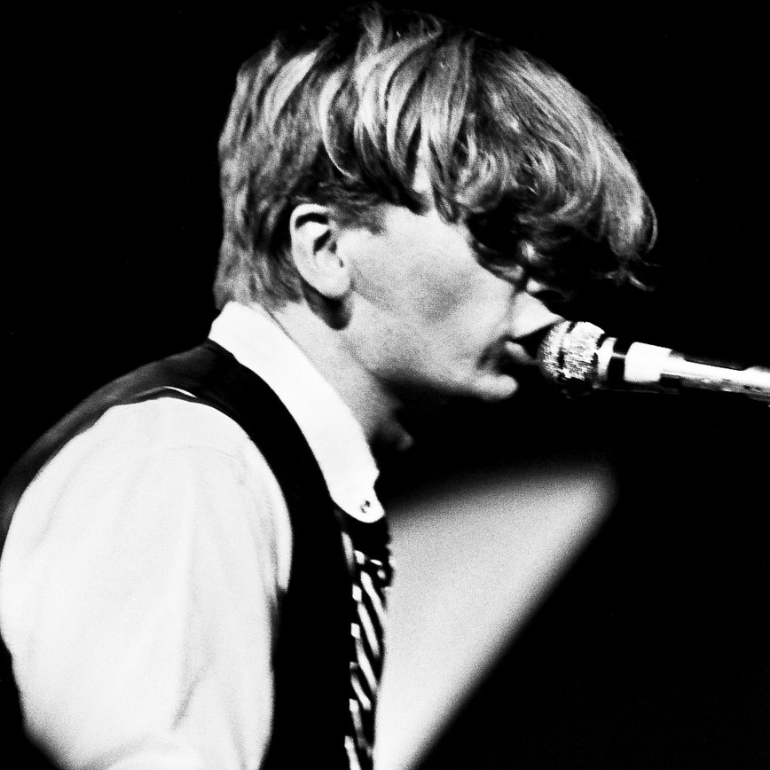
Ciechowski’s most famous songs
* „Yes, yes it’s me’’
* „Don’t ask about Poland’’
* „White flag”
* „Mammon ‘’

Slide 5
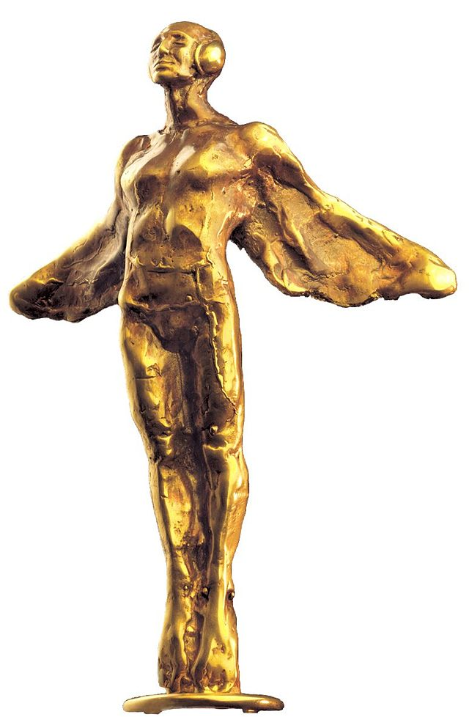
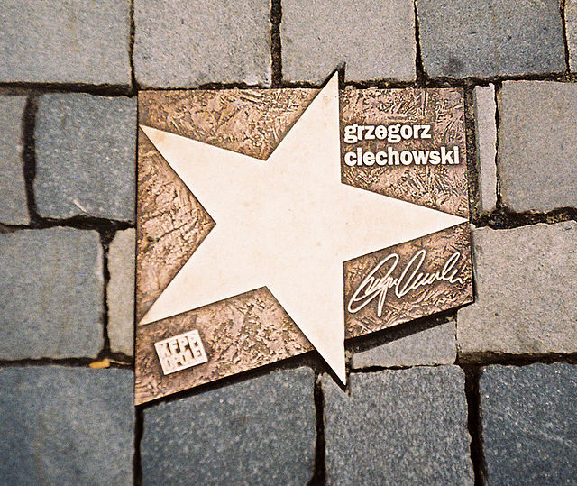
Awards
Ciechowski’s star at the Avenue of Stars in Opole
Ciechowski has won ten Fryderyk Awards for his music

