Slide 1
THE LIST OF FAMOUS POLISH PEOPLE
COMENIUS 2012 - 2014

Slide 2
LITERATURE
poet of a Juwish descent
poet, essayist, literary critic, translator, columnist,
poet, diplomat, prose writer, translator of Lithuanian origin

Slide 3
sport
Justyna Kowalczyk
Adam Małysz
cross country skier
ski jumper

Slide 4
sport
AGNIESZKA RADWAŃSKA
JERZY JANOWICZ
tennis players

Slide 5
sport
Robert Lewandowski „LEWY”
Jakub „KUBA” Błaszczykowski
football players

Slide 6
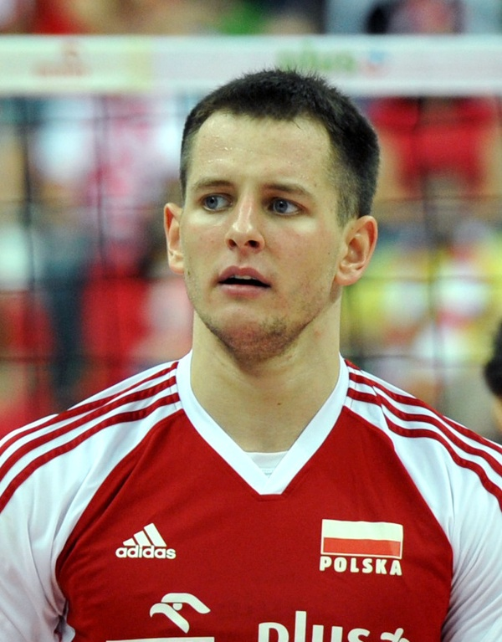
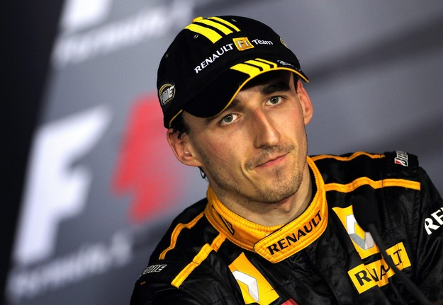
sport
Marcin Gortat
Bartosz Kurek
Robert Kubica
racing driver
basketball player
volleyball player

Slide 7
Sport
Krzysztof Hołowczyc
Tomasz Gollob
rally driver
speedway rider

Slide 8
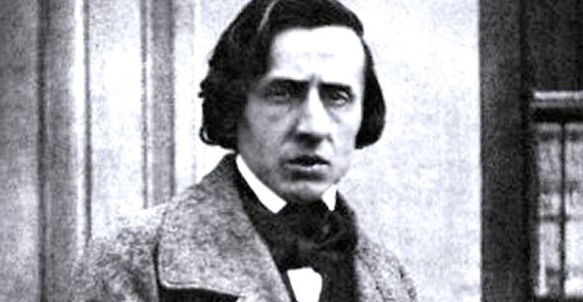
Music
Fryderyk Chopin
Maryla Rodowicz
Grzegorz Ciechowski
musician, composer, virtuos, music teacher
singer
musician, composer, songwriter, music producer, film music composer, poet

Slide 9
Music
Marek Piekarczyk
Czesław Niemen
singer, composer, multiinstrumentalist and songswriter
rock singer

Slide 10
music
Krzysztof Penderecki
composer and conductor

Slide 11
Science
Mikołaj Kopernik
Maria Skłodowska-Curie
astronomer, mathematician, lawyer,
classic scholar, economist, strategist, physician and astrologer
physicist and chemist

Slide 12
Film and theatre
Roman Polański
Andrzej Wajda
actor, director, script writer
film director

Slide 13
Film and theatre
Izabela Miko
Agnieszka Holland
film and TV director and screenwriter
actress, dancer

Slide 14
Film and theatre
Daniel Olbrychski
theater and film actor

Slide 15
politics
Lech Wałęsa
politician, trade-union organizer, philanthropist and human-rights activist

Slide 16
Historical figures
JAN PAWEŁ II
JÓZEF PIŁSUDZKI
pope
independence activist, a military commander,
politician

Slide 17
art
Jan Matejko
Witkacy
Nikifor
painter of numerous battles and court scenes, and a gallery of Polish kings
writer, playwright, poet, painter, photographer, philosopher
primitivist painter

Slide 18
art
Józef Marian Chełmoński
Jacek Malczewski
Stanisław Wyspiański
patriotic painter
painter of symbolism
painter, secessionist

Slide 19
Art
Tadeusz Makowski
Julian Fałat
Zdzisław Beksiński
landscape painter but first of all painter of Post-Impressionism and Cubism
impressionist
painter, draftsman, sculptor, photographer and artist who used computer graphics

Slide 20
art
Jerzy Duda - Gracz
Tadeusz Kantor
painter, surrealist and symbolist
painter of a surrealistic style

Slide 21
diverse
Eva Minge
Anja Rubik
fashion designer
fashion model

Slide 22
Diverse
Ludwik Zamenhof
physician and linguist

