Slide 1
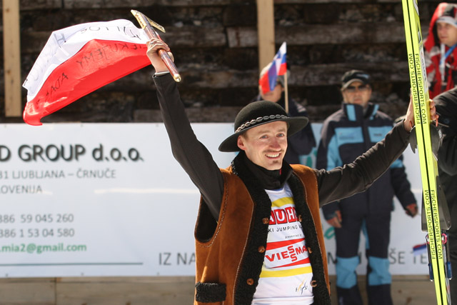
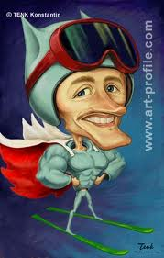
The Polish Eagle

Slide 2
Biography
Adam was born on 3 December 1977 in Wisła. His adventure with the sport has already begun since he was a young child. The first ski jump gave at the age of six. As it turned out it was the beginning of a spectacular international career. In 1995 he made his debut in the World Cup in Innsbruck. A year later, fans have watched the real explosion of talent and more success. Today, Adam is the most successful sportsman in the discipline of ski jumping.
His life motto is “Be good and just”.

Slide 3
Career
The most important of Małysz's successes are
- 4 individual Olympic Games medals,
- 4 individual World Championships gold medals (all-time record),
- 4 individual World Cup titles (all-time record shared with Matti Nykänen),
- 39 individual competition wins
- 92 podiums in total.
After concluding his ski-jumping career in 2011 he appeared in Dakar Rally in 2012 and 2013 reaching 37 and 15 respectively.

Slide 4
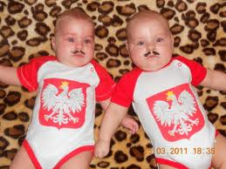
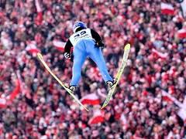
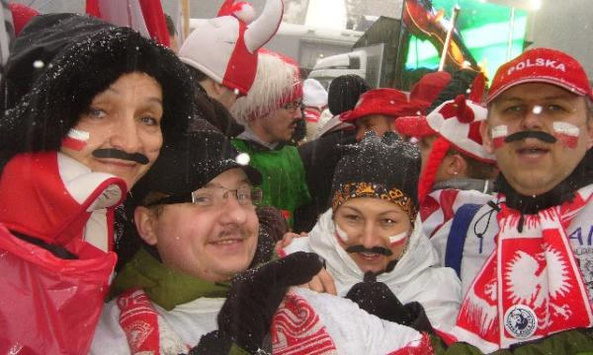
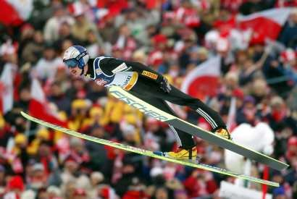
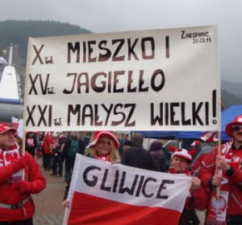
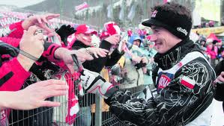
Adam Małysz and his fans

Slide 5
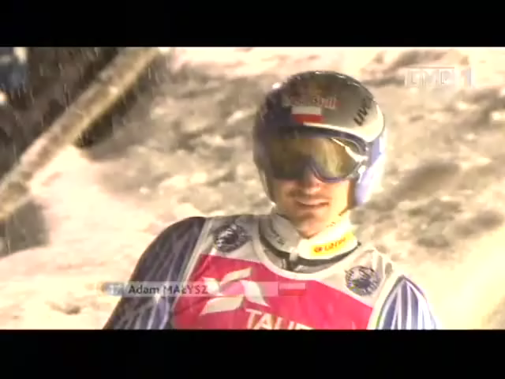
Adam Małysz’s last jump

Slide 6
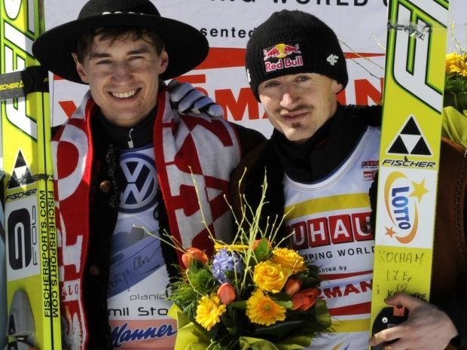
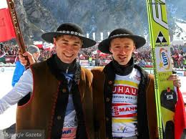
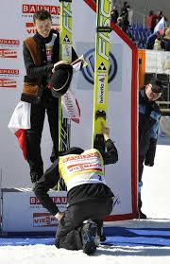
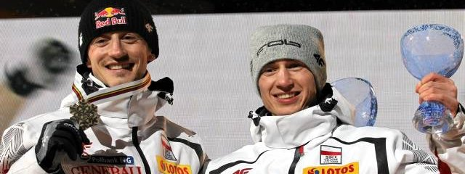
Successor of Adam Małysz – Kamil Stoch

Slide 7
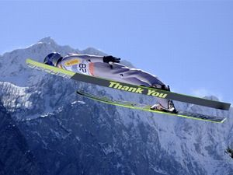
Thank you for watching
Created : Dawid Kaletka

Slide 8
Authors
Dawid Kaletka
Jakub Hornik
Michał Solarz

